Slide 1

CEIR End User-Training Manual

Slide 2

Agenda
End User Definition and Overview
Assumptions
Features
Check IMEI
Register Device
Update Visa
Grievance

Slide 3
End User - Definition
End user is the user who can be importer, distributor, tourist, foreigner, local Cambodian user, VIP who want to use the CEIR system.
Any stakeholder is a end user if stakeholder wish to use any of the functionality extended to End user.
There are two broad classification
Tourist/Foreigner with SIM based devices who is travelling on
>> Visa as issued By Cambodian Government
>> No Visa as there are bilateral relations between two countries and visa is not required
>> Tourist can be a VIP user
Local Cambodian User
>> Who has travelled aboard and bring a device into country for personal use
>> Local Cambodian Citizen can be a VIP user

Slide 4
End User – Classification
Classification based on nationality and status
Foreigner User is identified by Passport
National User is identified by National ID OR Passport

Slide 5
End User – VIP
VIP user has to register the device
VIP user has to update the visa
VIP user has to pay the taxes
However, VIP number are part of Exception List. The priority of Exception list is the highest
If the number exist in Exception list, then no policy is applied and device is allowed to be used in the network.
So, in essence, the device of the VIP user will never go in either greylist or black list
VIP user will never receive a notification to regularize the device.

Slide 6
Overview
End user is not required to register using DMC Home Portal
End user has to provide information about themselves while using CEIR services
All CEIR services are available on DMC Portal
The list of services are as follows:
Check IMEI
Register Device
Update Visa
Grievance
Stock upload (Anonymous)
End User can check the status of request using transaction ID allocated when the request was initiated
Email Notification to keep track of the status of various operations

Slide 7
Assumption
Following regulation is already in place for end user:
Local Cambodian user should register the devices that they purchased at foreign land, should declare the same to custom and pay applicable taxes if any
Foreigner who intend to use local SIM should register the devices. Devices up-to a certain count (say 2) is allowed to be registered free of taxes
Foreigner who bring more devices beyond a permissible limit would need to declare the same to custom and pay applicable taxes if any.
Foreigner should update their visa and travel details so that there device is whitelisted in the network for the given period.

Slide 8
End User – System Interface

Slide 9
Registration – End User
There is no registration requirement for end user.
Once the end user register the device, it also register information about himself/herself
A temporary / permanent account is created accordingly depending on whether foreigner /national user is registering the device
For local Cambodian user who is registering the devices would lead to creation of permanent account as that device is assumed to be used in the network permanently.
For Foreigner who is would lead to creation of temporary account as that device is assumed to be used in the network temporarily during the stay in Cambodia.
All temporary account would be de-registered on the expiry of visa. In case of visa details is not provided, the account is created for a configurable period of time (say 1 month)

Slide 10
Sequence of Activity
Foreigner with local SIM and unlimited Device
Register Device
Pay Tax
Buy SIM /use foreign SIM
Insert existing SIM or new SIM
Start using service
Cambodian User
Register Device
Pay Tax
Insert existing SIM or new SIM
Start using service
Foreigner On Foreign SIM
Nothing to Do
Foreigner with local SIM and limited Device
Register Device
Buy SIM
Insert existing SIM or new SIM
Start using service

Slide 11
Feature Mapping to End user Type

Slide 12
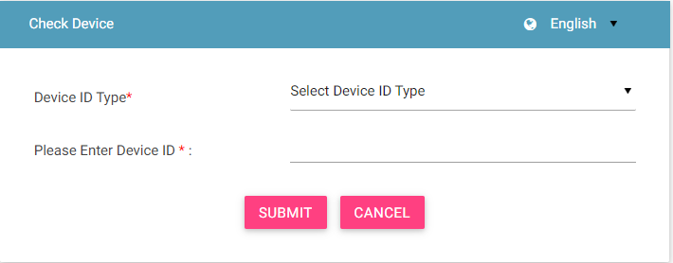
Check Device (IMEI)
Using this feature, user can check the status of the device (IMEI).
IMEI status is either VALID or INVALID
There could be multiple reason for IMEI status as INVALID. Some of them are listed below
The IMEI is globally blacklisted
The IMEI is marked as stolen
The IMEI is not tax paid
The IMEI does not contain valid character sets

Slide 13
Register Device
Using this feature, user can register their devices in the network.
User can be a foreigner or National user
VIP should also register the devices in the network
As part of registration process, user will share the following information
Personal Details (Name, Contact, Address)
Device Details (Device Type, IMEI, Multiple SIMs) for 1 or more devices
Travel Details (only for foreigner). Based on visa details, the number is added in the temporarily whitelist
Tax Related details (Pricing information)
Post registration,
National User to pay taxes with custom department
Foreign user can buy local SIM and start using the device, if count of registered device is less than permissible limit
Foreign user to pay taxes with custom department, if count of registered device is less than permissible limit

Slide 14
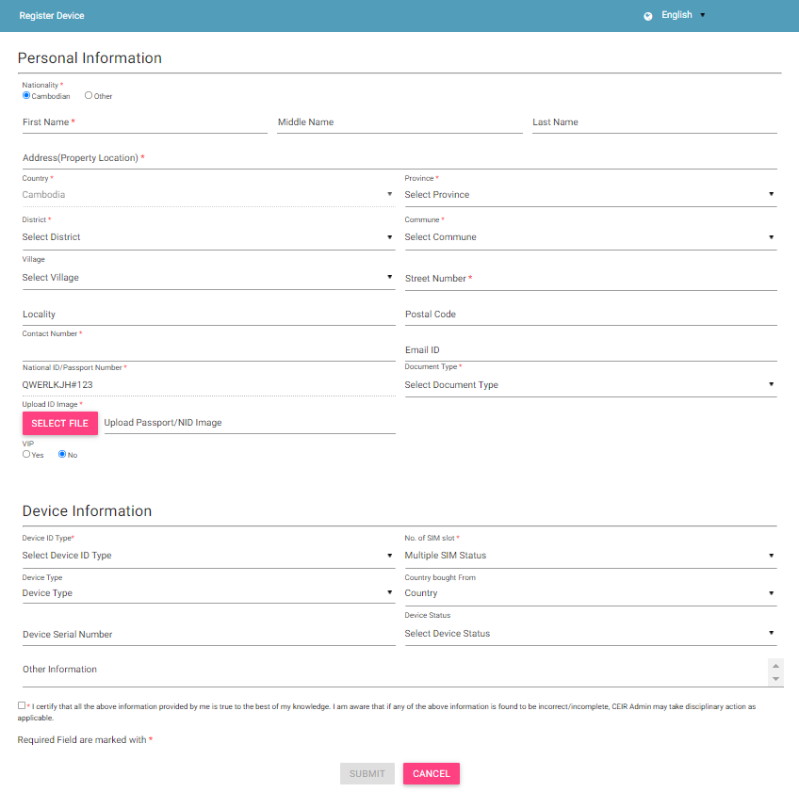
Register Device (Contd…)
Devices are de-registered once the visa expiry has happened
No need to register, if foreigner intend to use foreign SIM in the device

Slide 15
Register Device (Scenario – National User) – Post Grace Scenario

Slide 16
Register Device (Scenario – Foreigner User)

Slide 17
Register Device (Scenario – Foreigner User)

Slide 18
Register Device – Ways to Register
Cambodian User
Foreigner User
Self
Custom
Immigration
Self
Custom
Immigration
Scenario | Cambodian User | Foreigner User
# of Devices for which tax to be paid | Tax to be paid for all device. Every single device will attract tax. | Devices up-to a certain count per visit is exempted from tax.

Slide 19
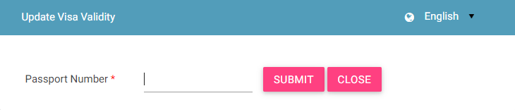
Visa Update
Using the feature, the foreigner user can update his visa period, if the stay is extended.
This will help the number to be maintained in the whitelist for the longer period of time.

Slide 20
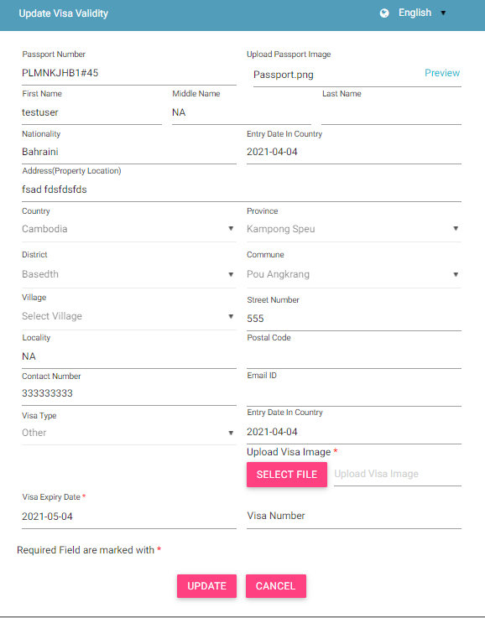
Visa Update (contd..)

Slide 21
Visa Upload (Only for Foreigner User – First time)

Slide 22
Visa Upload (Only for Foreigner User – Second Time)

Slide 23
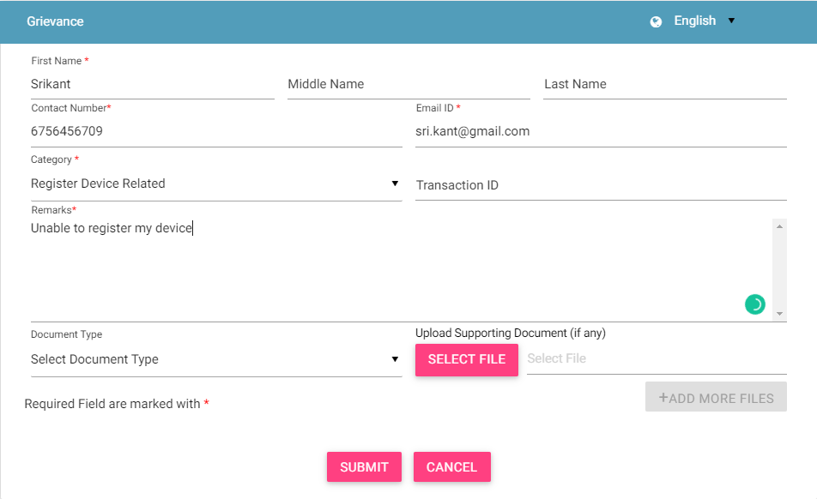
Grievance – End User
As a end user, you can register grievances when there is a problem in the portal.
For example, there could be situations when the registration feature is not working or there could be some issues with the check IMEI
Step 1 :

Slide 24
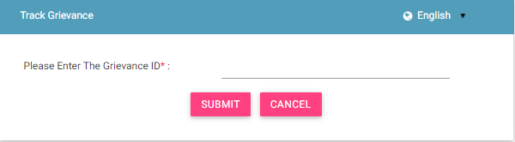
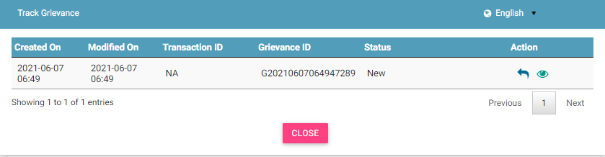
Grievance – End User (contd.)
Step 2 :
Step 3 :

Slide 25
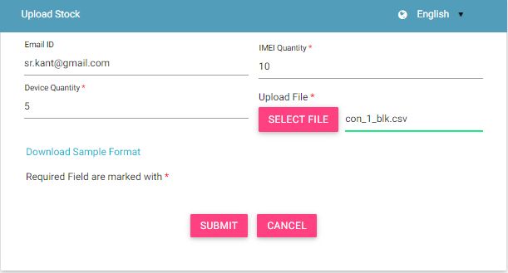
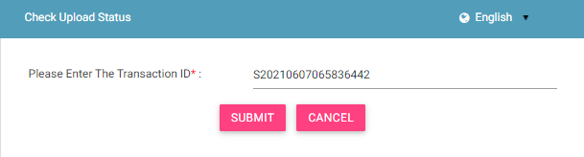
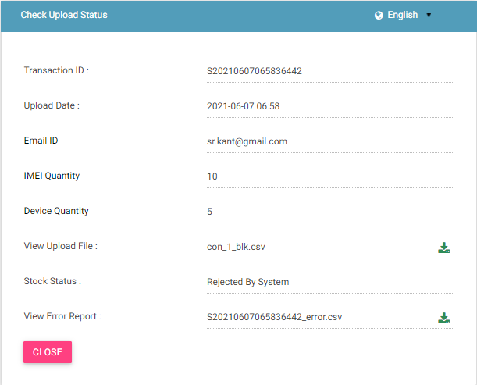
Stock Upload – Anonymous
User can also upload stock as Anonymous in case want to keep their identity as hidden.
Step 1 :
Step 2 :
Step 3 :

Slide 26
Queries

Slide 27
Thank You

